Slide 1

CUDSY
Columbia University Data Science Yelp

Slide 2
Introduction
What is the data?
Yelp restaurant data near Columbia
Why analyze the Yelp data?
Find better way to view search results
Implement new features
Our visualization concepts
2D Search (User Preferences)
Food Map D3
Food Map Algorithm
Discovering Similar Restaurants
Note: The Yelp dataset is from 2012

Slide 3
Why analyze the Yelp data?
There are missing Yelp features that we want to see implemented
Given a restaurant, what other restaurants might users like (similar to Netflix recommendation system)?
What dishes are most popular at a particular restaurant?
Given user price and star preferences by cuisine, which restaurants should be recommended?

Slide 4
2D Search

Slide 5
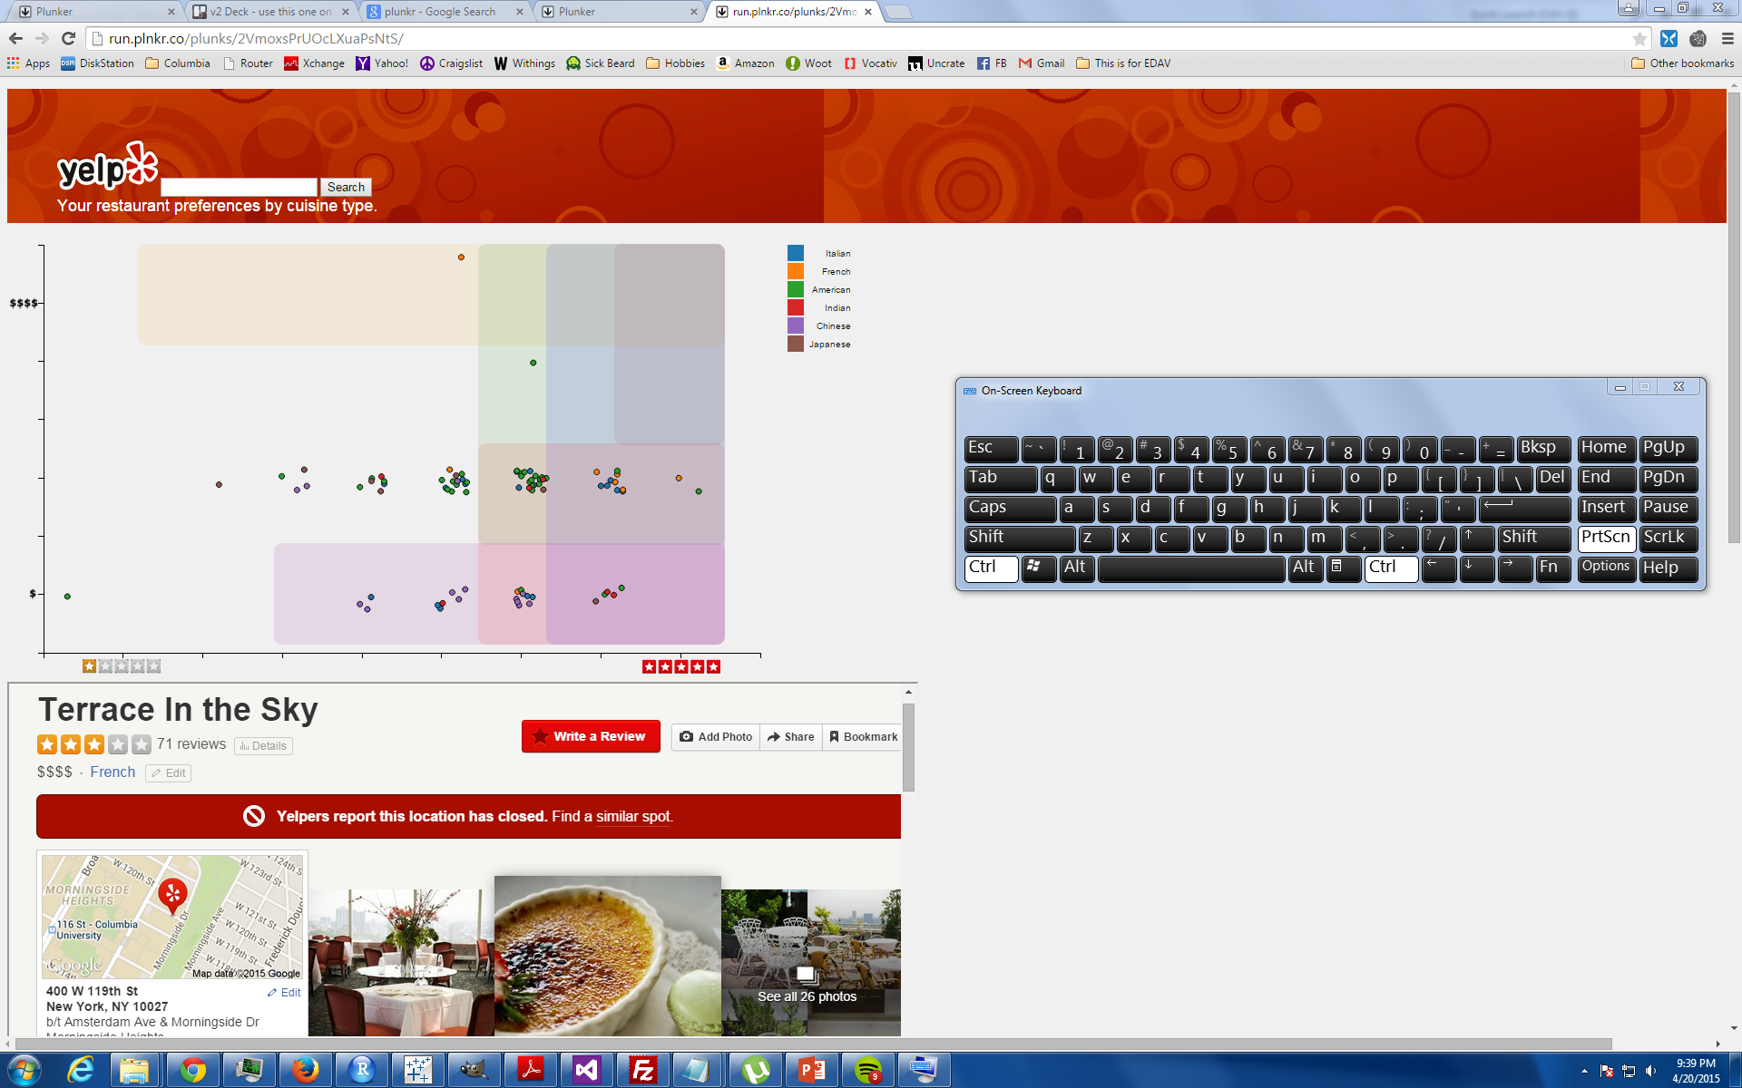
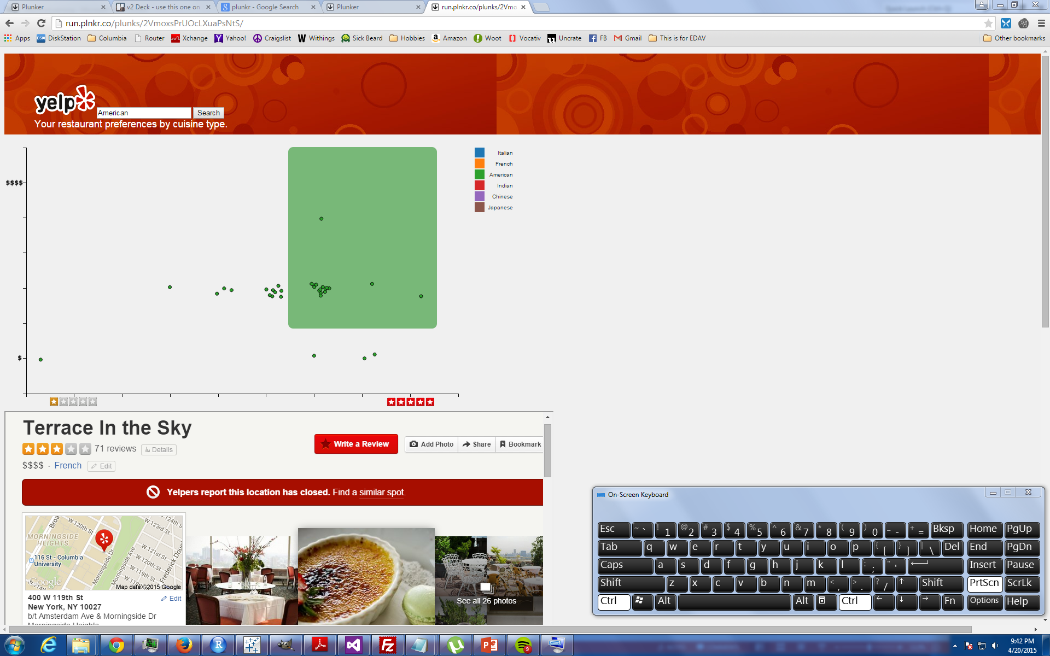
2D Search (User Preferences)
1
Users top cuisine choices
2
Filter to tonight's choice
3
One click to see details
2D Search

Slide 6
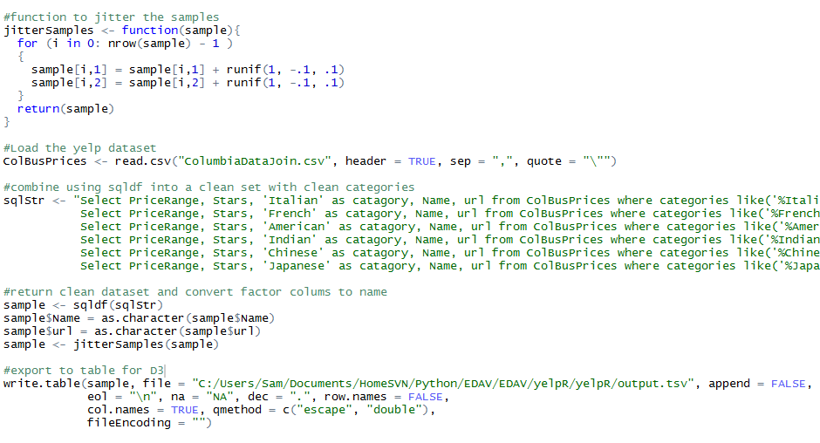
2D Search (R Code)
3
Jitter Samples a bit
1
Read Data into memory
2
Sqldf to clean and filter
4
Output clean .tsv for D3
R Code in Markdown

Slide 7
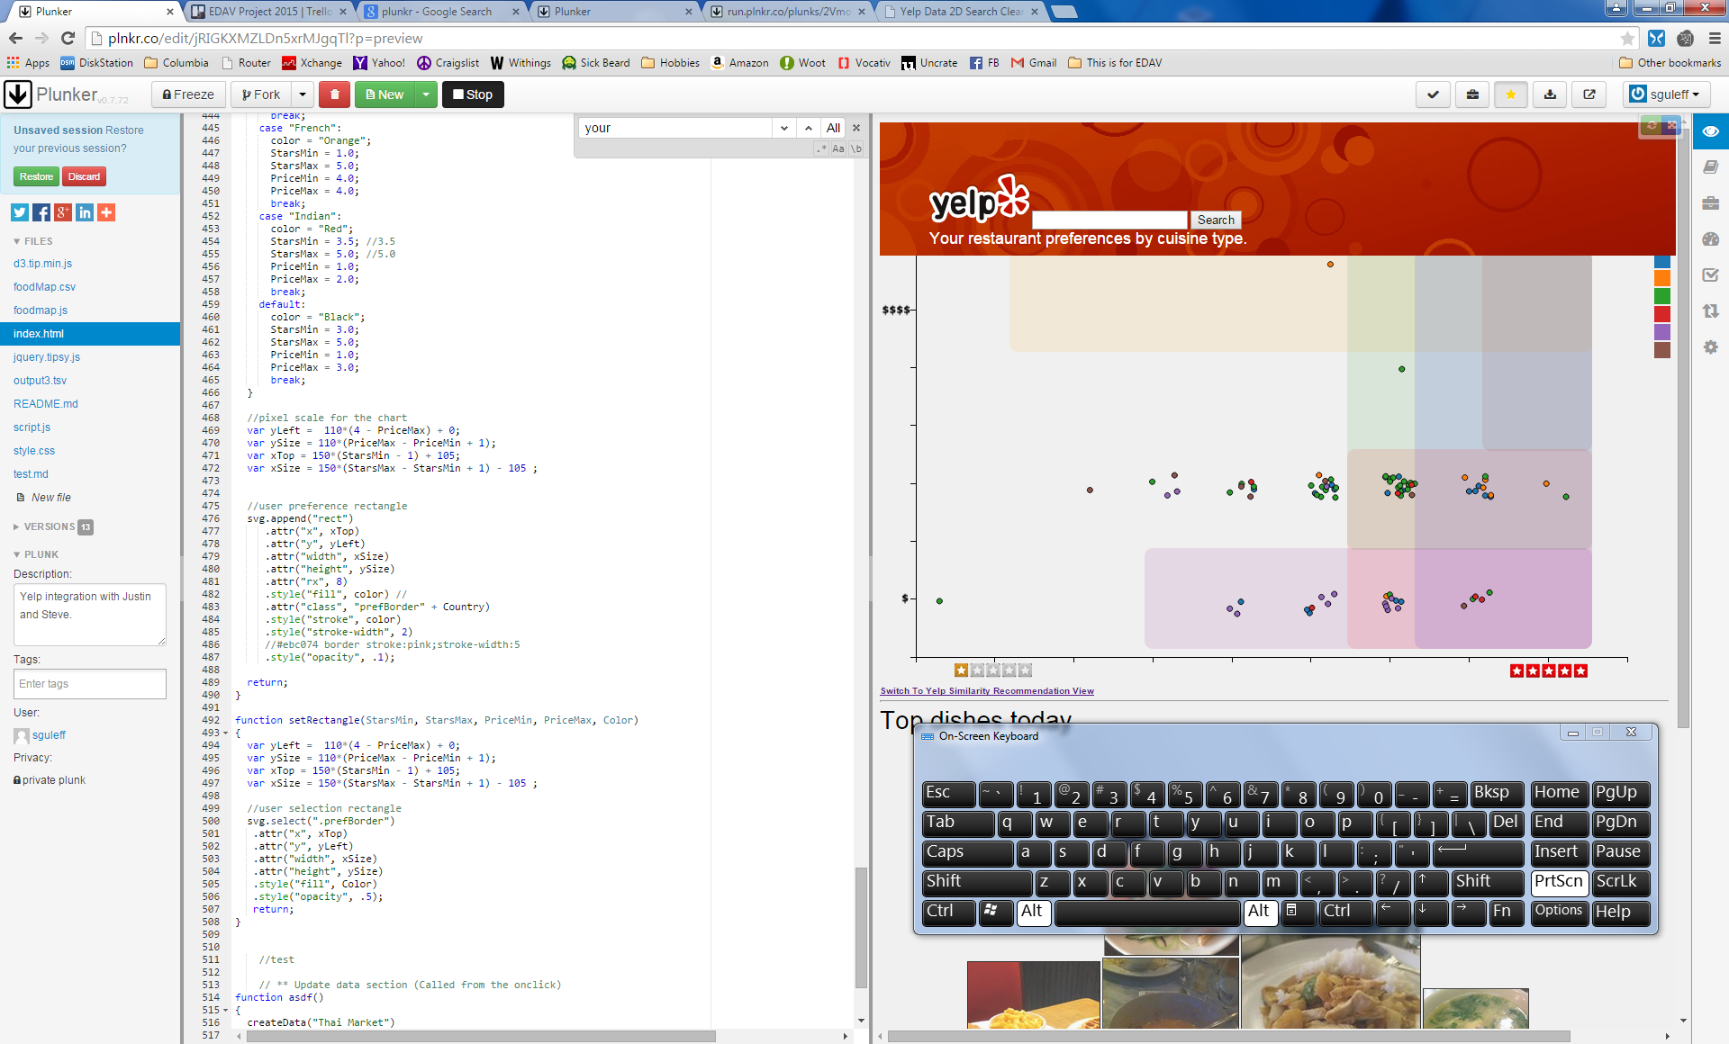
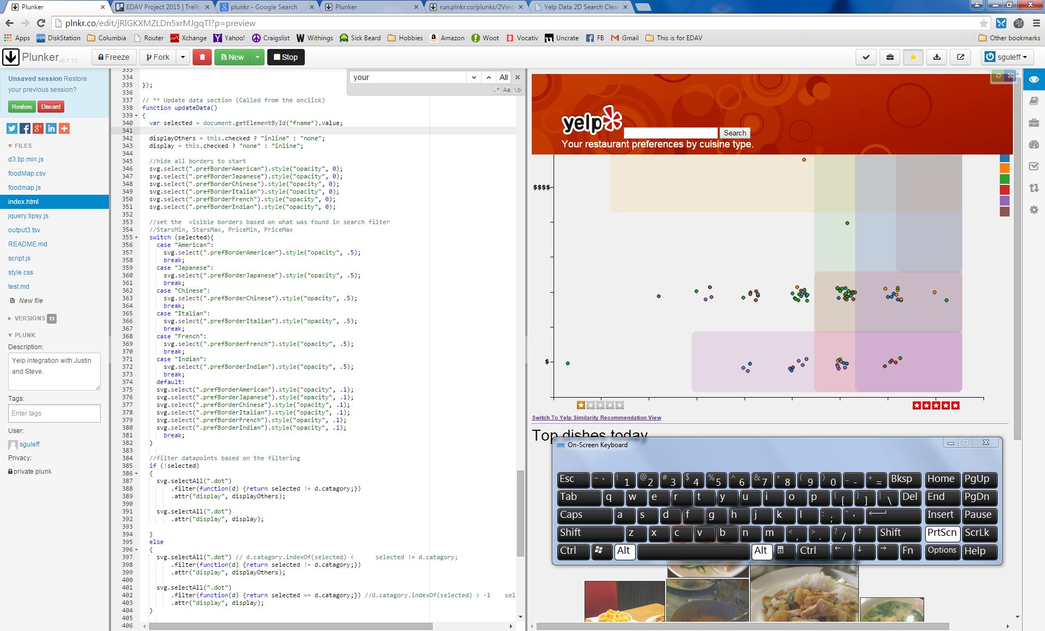
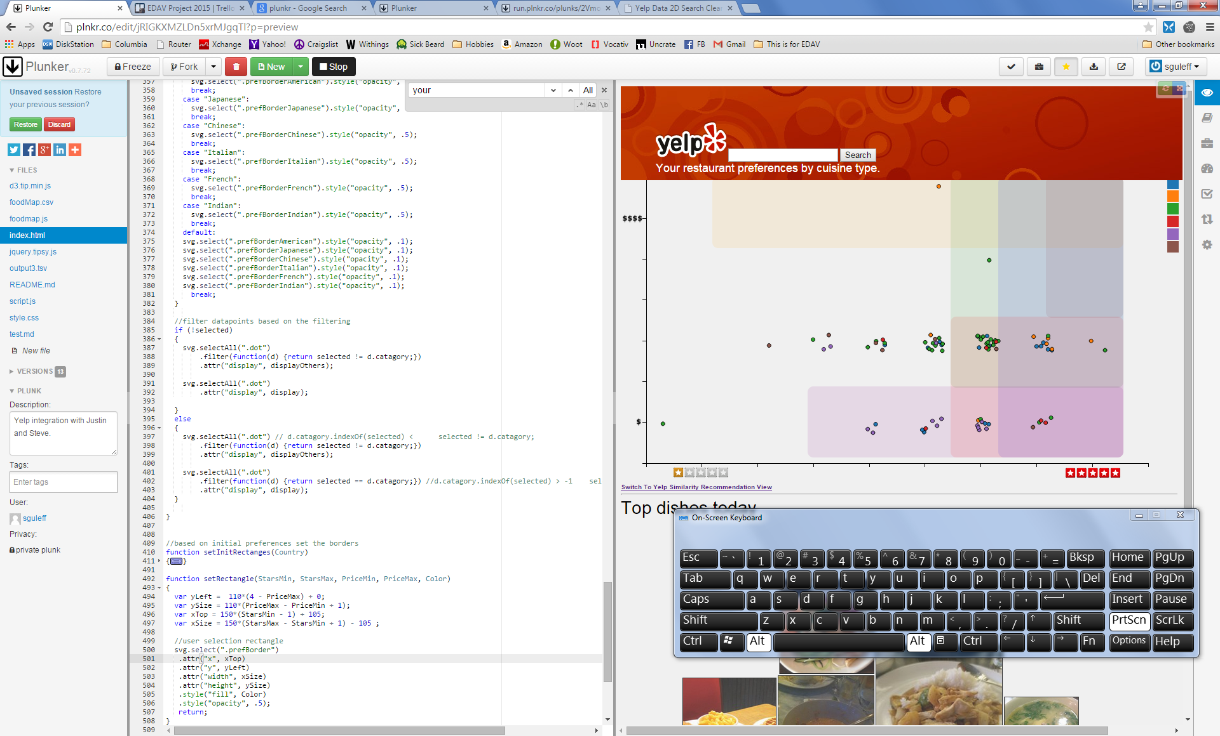
2D Search (D3 Code Highlights)
Set boarders based on $ and Rating
Update view from search
…
D3 Code in Markdown

Slide 8
Food Map

Slide 9
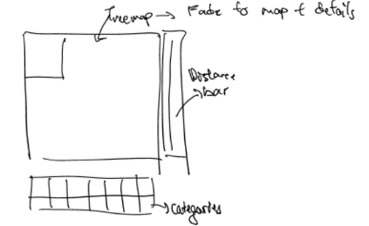
Food Map D3
Food, not restaurants
Pictures, not names
Visual, not text
Squares, not rectangles
Spiral, not sequential
Washington Post 2014 Presidential budget visualization
http://www.washingtonpost.com/wp-srv/special/politics/presidential-budget-2014/
Notes:
For the Yelp dataset I would like to explore a different kind of visualization. One of the main things I think Yelp doesn’t really do well is recommend you food. Yelp is at its core a business recommendation service and it is similar for food. I would like to break this down and introduce food recommendation directly to users.
So since we’re dealing with food, naturally it should come to mind that we should use the photos of the food rather than their names. A food name can be ambiguous but a food picture tells a lot about the food. It includes even information more than the food itself. Such as the plate and the utensils used so from that you could potentially infer the

Slide 10
Algorithm for drawing squares
To draw a square in D3, we need:
Upper left coordinate of the square
Edge length of square
Algorithm should:
Input: an array of edge lengths
Output: coordinates and scaled lengths of squares
Minimize: total width and length used
Written in javascript so compatible with d3

Slide 11
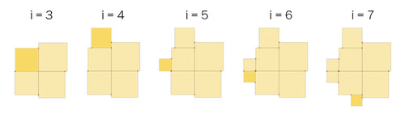
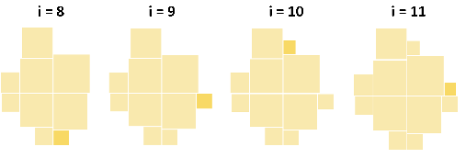
Food Map Algorithm
https://sites.google.com/site/e90e50fx/home/square-chart-and-treemap-in-excel

Slide 12
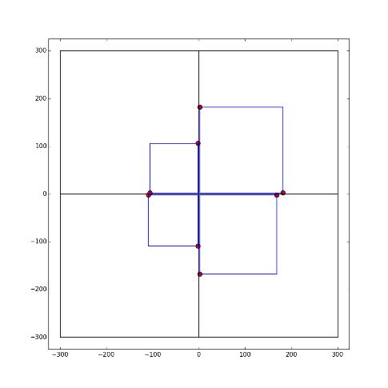
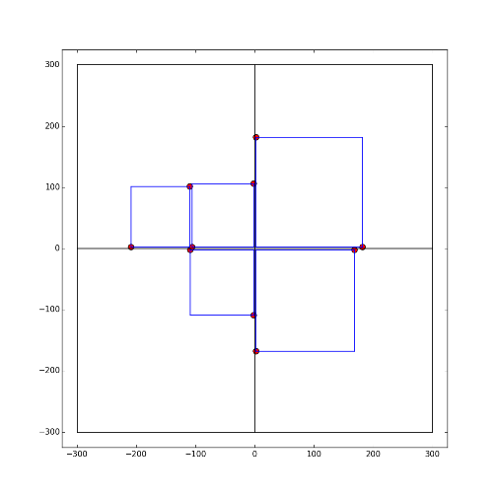
Prototyping in Python
Red points in the figure represent allowable locations for placing squares

Slide 13
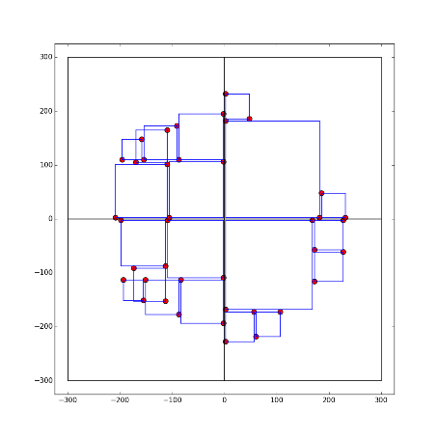
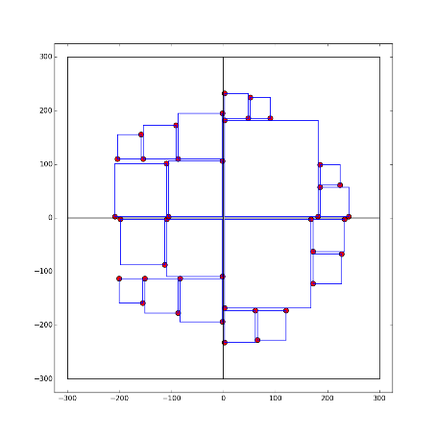
Overlapping issue
For each new optimal point, check if adding a square there would result in overlapping

Slide 14
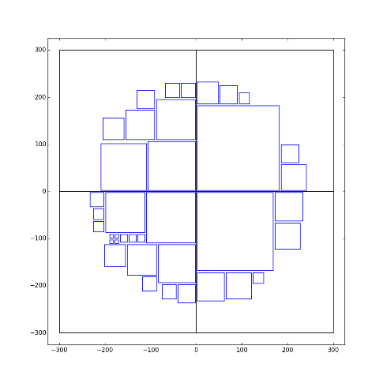
Still room for improvements…
Filling squares in empty spaces between squares (back filling)
Scaling should be applied to all the squares
Greedy algorithm: not guaranteed to be ideal for all squares

Slide 15
Food Map Data Scraping
196 Restaurants Listed on 2012 Data
93 Restaurant Menus Available
5801 Food Items
383 Food Items with Photos
335 Food Items with Photos and Reviews
54 Restaurants Remaining
Photos are tagged to reviews
Reviews tagged to food on Yelp are based on basic string matching
Reviews can be tagged to more than one food

Slide 16
Discovering Similar Restaurants

Slide 17
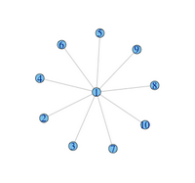
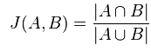
Discovering Similar Restaurants
Feature-based recommendation
User-based recommendation
Collaborative filtering
Jaccard Index
Matrix Factorization

Slide 18
Discovering Similar Restaurants
Collaborative filtering and matrix factorization to identify similar restaurants
Leaflet with bubbles sized according to rank of similarity to visualize restaurants on map
Shiny interface to allow:
Searching of restaurants
Sortable data table
Restaurant information

Slide 19
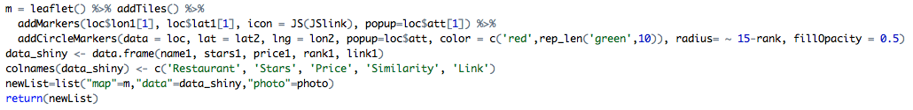
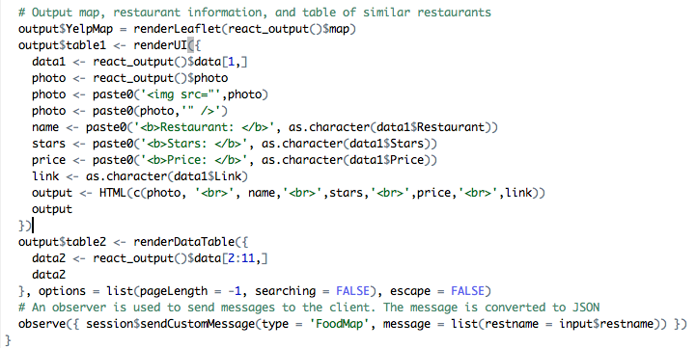
Discovering Similar Restaurants
Creating the Leaflet map and data table, and passing it to the Shiny output
Shiny Output – Integrating Leaflet, data tables, and Passing restaurant name to FoodMap

Slide 20
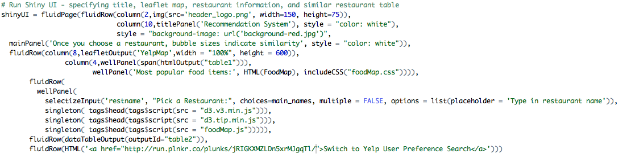
Discovering Similar Restaurants
Shiny UI – Integrating Leaflet, similar restaurants, and FoodMap

Slide 21
Integration and Conclusion

Slide 22
Integration
Merging FoodMap (built in D3) with Shiny/Leaflet app
Passing input restaurant in Shiny as variable to FoodMap.js file
Placing FoodMap in div tag within Shiny app
Merging FoodMap with user preference 2D search (both built in D3)

Slide 23
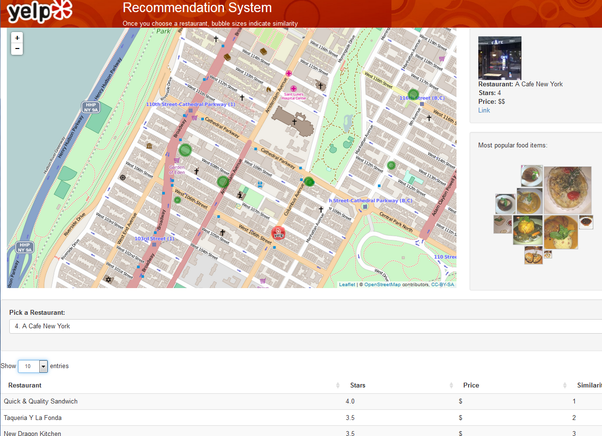
Integrated Designs
Similarity with Food Map
2D Search With Food Map

Slide 24
Lessons Learned and Next Steps
One letter global variables should be avoided (thanks, Leaflet and Steve)
Implement Leaflet in JavaScript instead of an R Leaflet package to allow enhanced functionality
Clicks on map can be tracked and passed back to script

Slide 25
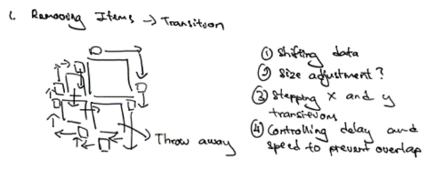
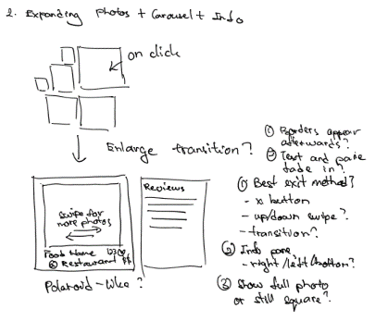
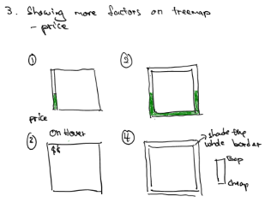
Next Steps – Food Map

